Slide 1
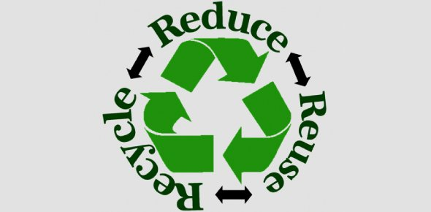
Anti-wastage Application
A vaccination for viral wastage

Slide 2
The problem that I want to resolve
I get devasted on seeing the amount of harm caused by plastics to the environment. People throw Cadbury packets, makeup boxes which lie recklessly in the landfills which only contribute to the degradation of the environment.
An idle solution would be that the respective companies who own the products take back their packaging materials and reseal new products in the same packaging.
This way not only the environment would be saved but the company can also avail this opportunity to save their expenses which would have been used in new packaging.

Slide 3
The design for the application
First of all ,there will be a login and sign up screen where the user will be able to sign up or login
Secondly, there will be the home screen where there will be a list of companies to choose from, which will take their respective packaging.
Next, there will be a town screen where there will be a list of towns to choose from, where the user is residing.
Next there will be a donation cum market screen where the person can type the item and the number of item packages he/she wants to return. There will also be a dropdown where the user will get a dropdown of the nearby mega mart where he can donate.
Lastly a donate button will be there to finally give off the packaging.
We will also have a receiver screen to see the number of donations and points acquired by the user in lieu of which the company would give due prices or offers to the donor.

